Slide 2
Storyboard Guidelines
All projects are different but there are standard tools that benefit each project
Include your own versions of all the slides shown in this sample storyboard (unless listed as optional)
Add additional slides based on your project
Include supporting slides in the Appendix
Remember to add your summary of the results of using each tool in the “Key Learning” space

Slide 3
Executive Summary—A3

Slide 4
Define Phase

Slide 5
Project Charter

Slide 6
SIPOC
Key Learning: Patient is the “thing” moving through the process.

Slide 7
Voice of the Customer
Key Learning: Patients were concerned with delays in hospitalization.

Slide 8
Swimlane Map
Key Learning: Decisions and rework fall to the Hospitalist.

Slide 9
Measure Phase

Slide 10
Data Collection Plan
Key Learning: Data Collection uncovered multiple disparities in the process.

Slide 11
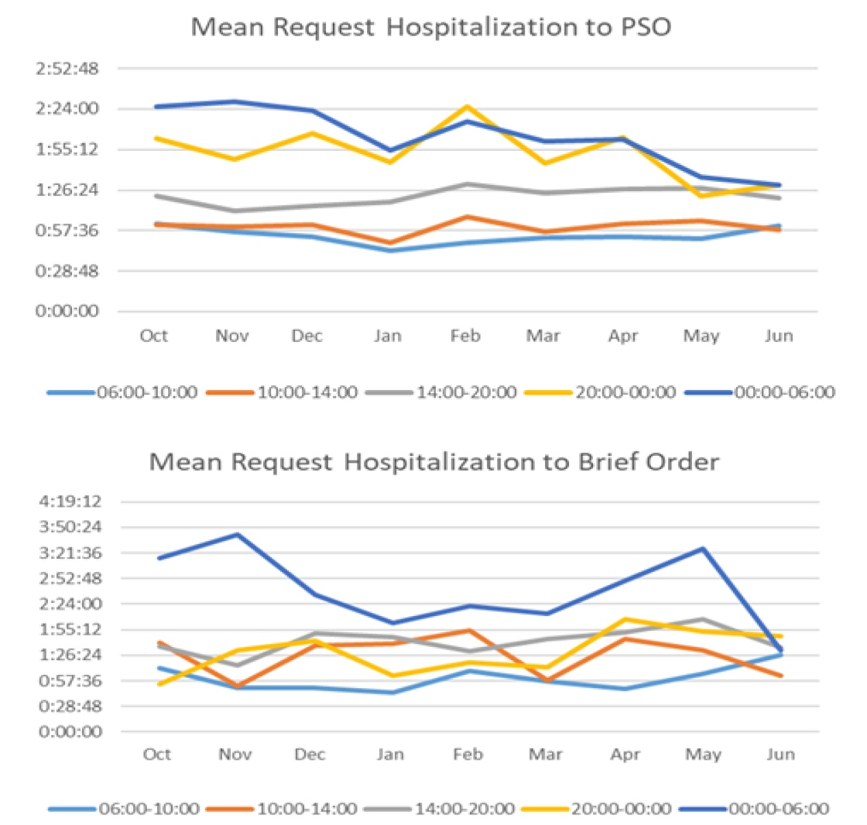
Baseline of Project Y
Key Learning: The longest mean time to hospitalize a patient is in the 00:00 to 06:00 shift.

Slide 12
Analyze Phase

Slide 13
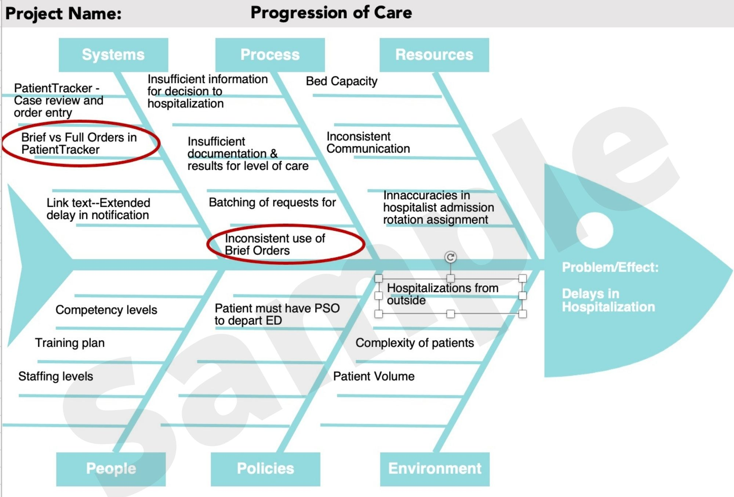
Fishbone Diagram
Key Learning: Brief Orders have been prioritized as the main area of improvement.

Slide 14
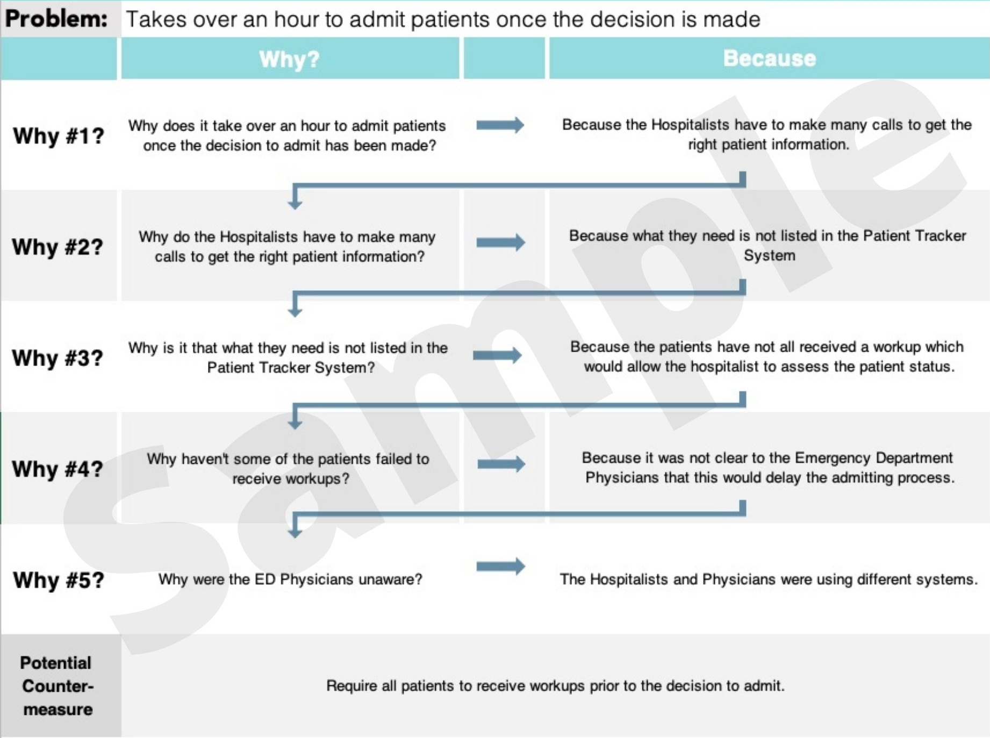
5 Whys (optional)
Key Learning: Potential improvement to have workups done earlier.

Slide 15
Root Cause Confirmation
Key Learning: Data shows verifies all 3 root causes (see next slide for charts).

Slide 16
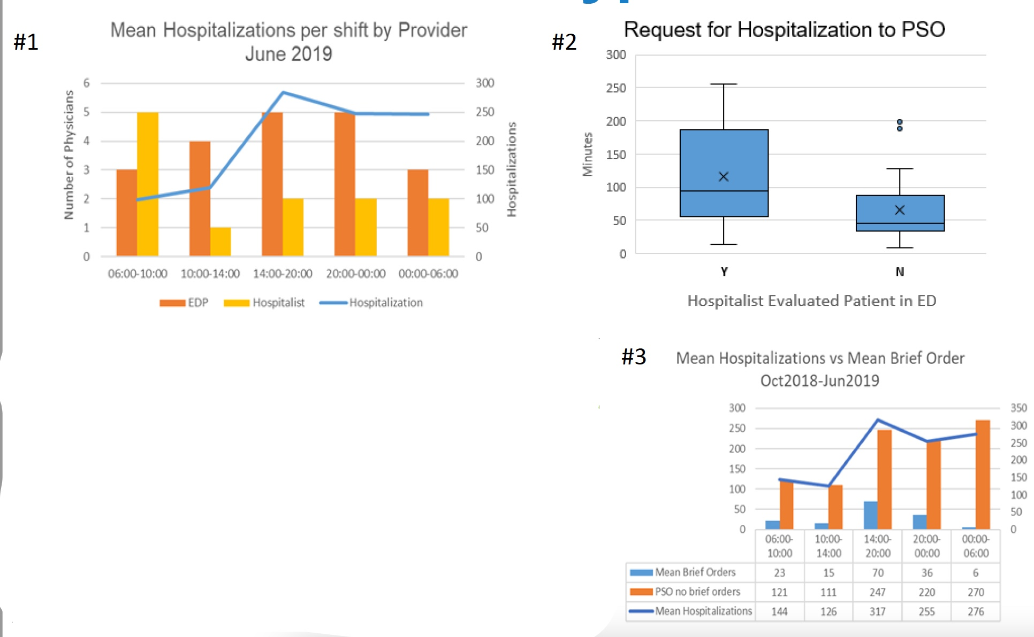
Verification Visuals (if available)
Key Learning: (see previous slide for corresponding root cause hypotheses)

Slide 17
Improve Phase

Slide 18
Solution Selector
Key Learning: It was not feasible to adjust staffing so the team focused first on utilization of brief orders for hospitalization.

Slide 19
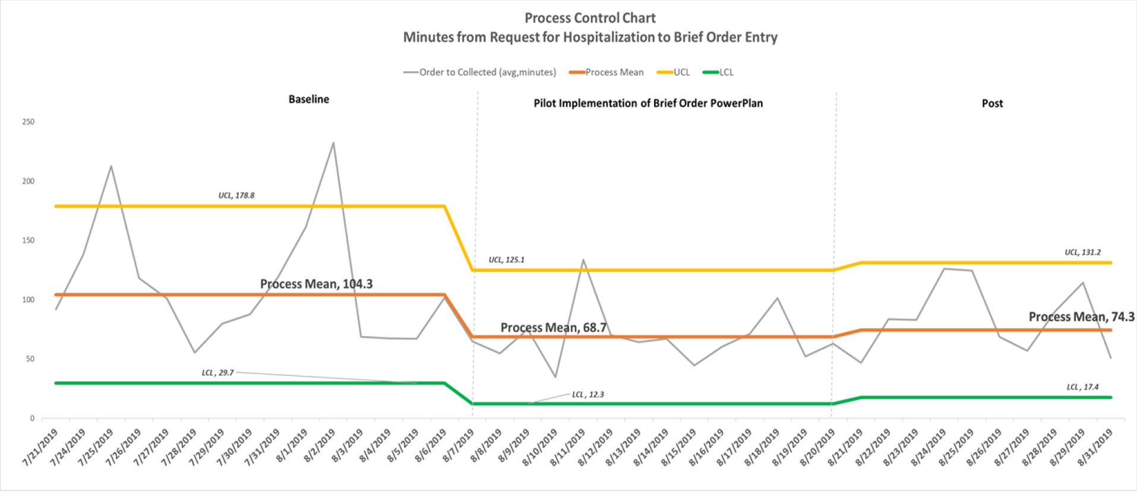
Time Chart – Before & After
Key Learning: Using brief orders for hospitalizations reduced time from request of hospitalization to PSO/Brief Orders from 104 minutes to 69 minutes—a 34% improvement in the average.

Slide 20
Monitoring & Response Plan
Key Learning: To sustain success with Brief Orders, it will take monitoring from the team to ensure utilization of Brief Orders for hospitalizations.

Slide 21
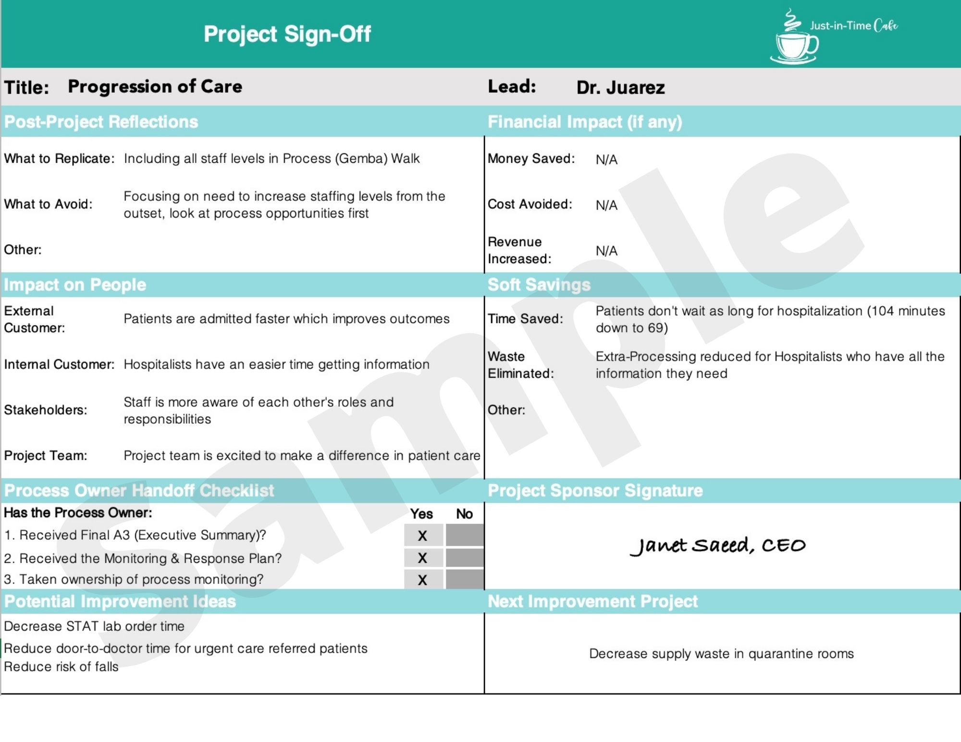
Project Sign-Off

Slide 22
Appendix

